Slide 1
All a Twitter About Literature
TWEETING ABOUT SHAKESPEARE’S MACBETH
AP ENGLISH IV
SWEENEY

Slide 2
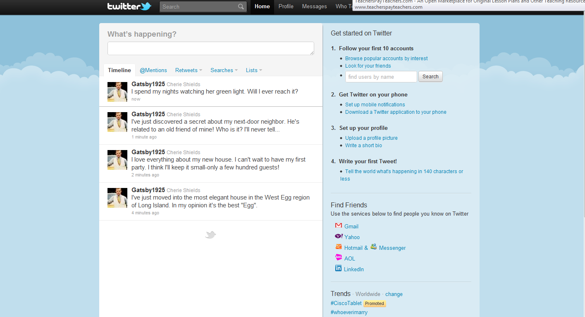
Set up a Twitter account for your character.
You must include:
a Twitter handle related to your character @Gatsby1925
a picture for your character
a brief bio for your character
Here is an existing example of a Twitter account for Gatsby1925

Slide 3
How to set up a Twitter account.
1. Go to https://twitter.com/signup and create one account for each major fictional character in the novel.
For example: Jay Gatsby or Katniss Everdeen.
Come up with a username such as (JayGatsby1925 or KatnissDistrict12)
Come up with a password (ex. Gatsby101).
Once you set up this Twitter account, you can keep it for years to come. Use the same email address, username and password.

Slide 4
Character Tweet Guideline Sheet
1. Students must create at least 20 Tweets from the point of view of their assigned characters. Remember, all tweets are limited to 140 characters so be concise.
10 Tweets must be directly related to your character, and 10 of the Tweets must be reflective and responsive to the story. Think depth and understanding.
2. All Tweets must be appropriate for a general audience. No inappropriate content or foul language.
3. Students will be evaluated on their general knowledge of the plot of the play along with how well they know the assigned character.
4. 10 of the tweets must be about events going on in the character’s life (the plot).
5. 10 of the tweets must be personal observations from the character’s point of view about the following: the setting, other characters, events going on in the story, things other characters have said to them, their hopes about future events, etc.
6. All tweets must be original.
7. Retweets will not count toward the total number of tweets.
8. Follow @mchsAPmacbeth.

Slide 5
Example of a twitter feed for Gatsby.
Students can interact and respond to each tweet. You can require a minimum number of responses per student.

Slide 6
Reply feature on Twitter
@replies
Use an at sign @ in front of a Twitter username to reply to someone. So, for example, the tweet. @Reply – Using the example of “@Gatsby1925” you can respond to any user using the @ symbol, followed by their name. That post will appear on the user’s wall.
-Characters may interact with each other! You must stay in character in order to respond to tweets.
During this assignment, Mrs. Sweeney will be following the twitter accounts to see the progress and to monitor the appropriateness of student involvement.
Follow @mchsAPmacbeth.

Slide 7
Positive Interaction
Because the Tweets are so short, you can read the tweets in short bursts. You can stay updated on the plot and characters from the play your class is reading all day. It’s like being immersed into the lives of characters. You get to experience what Gatsby is feeling, and seeing through his “Tweets.”
You access your social media all the time anyway, why not use this resource in a positive, educational way?

Slide 8
Cite!
You must cite where you are obtaining information from during this assignment.
Add a hashtag (#) and the Act and Scene information for each tweet.
#A1S1 would mean Act I, Scene i
Use stage directions and scene descriptions to help understand the play and what the characters are doing.

Slide 9
Presenting the Tweets!
You will be asked to respond to the quality of the tweets or the content once this activity is complete.
Tweets are due by 11:59 pm on Wednesday, December 21, 2016.
By asking you to complete this assignment, I want you to focus on close reading the text for better understanding of what your characters are saying and meaning.
You will be asked to close read an excerpt from the play and write an essay as a final assignment connecting to this activity.

Slide 10
Basic Twitter Terms
Twitter – Website that allows users to create and follow other accounts.
Tweet – A post by yourself or another user.
Retweet – Reposting something someone else has tweeted.
Retweet (Quote Tweet) – Quoting something someone else has tweeted.

